Slide 1
Office 365 Development

Slide 2
Course Agenda
Introduction to Office 365 Development
Module 1: Deep Dive Apps for Office in Outlook
Module 2: Deep Dive Apps for Office in Word
Module 3: Deep Dive Apps for Office in PowerPoint
Module 4: Deep Dive Apps for Office in Excel
Module 5: Deep Dive into SharePoint Hosted Apps
Module 6: Deep Dive into Provider Hosted Apps
Module 7: Deep Dive into Security and OAuth
Module 8: App Lifecycle Management

Slide 3
Deep Dive into SharePoint-Hosted Apps

Slide 4

Agenda
Introduction
Programming in JavaScript
App Parts
UI Custom Actions

Slide 5
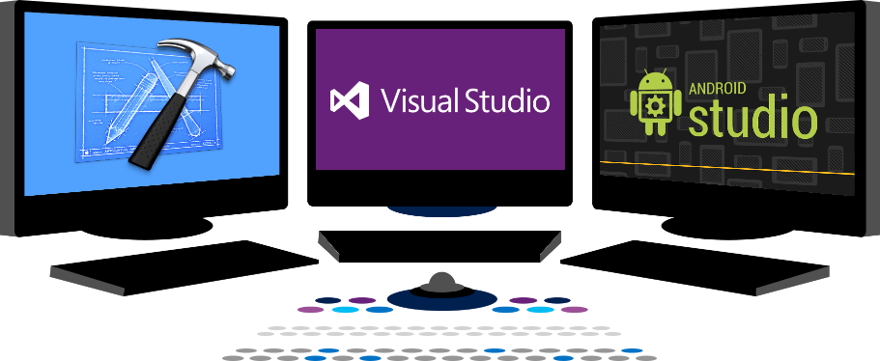














Vision
EXTEND OFFICE EVERYWHERE
CONNECT TO OFFICE 365 SERVICES
BUILD USING AN OPEN PLATFORM
Delve
z
Users and groups
Files
Mail
Calendar
My Apps
Video Portal
Contacts
Office Graph
Presentations
Documents
Spreadsheets
Lync
OneNote
Yammer

Slide 6
Introduction

Slide 7
Architecture
SharePoint 2013
Host Web
App Web
Web Services
Notes:
App Web is a sub web under the host web
App web is a separate domain
App web is created during app installation process
App web contains pages and other declarative SharePoint artifacts
App web is limited to JavaScript
App web can access host web as long as it has appropriate permissions
May call to other cross-domain resources using appropriate techniques such as cross-origin resource sharing (CORS) or a web proxy

Slide 8
The App Web
App Web is isolated in its own domain
Enforces “Same Origin” policy for the app
Allows for authentication and authorization when calls are made to the host web
Each app has it’s own unique URL
Tenancy – your organization’s tenancy
App Unique Identifier – unique generated identifier for the app instance
Hosting Domain – defined for each farm
App Name – contained in the app manifest
https://[tenancy]-[appuid].[hostingdomain]/[appname]
Notes:
Each app web is isolated in a unique domain

Slide 9
App Start Page
Specified in App Manifest
~appWebUrl/Pages/Default.aspx?{StandardTokens}
Utilizes Tokens for dynamic replacement of parameters
~appWebUrl token representing the URL for the app web of this app instance
{StandardTokens} passes key query string parameters to the app on launch
Parameter | Description
SPHostUrl | The URL of the host web
SPAppWebUrl | The URL of the app web
SPLanguage | The language/culture of the host web
SPClientTag | The client cache control number for the current website
SPProductNumber | The full build version number of the SharePoint farm
Notes:
{StandardTokens} combines five other tokens. It initially resolves to SPHostUrl={HostUrl}&SPAppWebUrl={AppWebUrl}&SPLanguage={Language}&SPClientTag={ClientTag}&SPProductNumber={ProductNumber}. Then each of these tokens resolves. If there is no app web, the portion &SPAppWebUrl={AppWebUrl} is not present.

Slide 10
App Permissions
Utilizes “Internal” Authentication
App permissions are the lesser of user and app permissions to the given resource
Notes:
No Oauth tokens required

Slide 11
App Shapes
Full Page
Required for all apps
Experienced when an app is launched from the contents page
App Part
Optional
Allows an app to be hosted in an IFrame on the host web
UI Custom Action
Optional
Allows an app to be launched from the ribbon or Edit Control Block(ECB)
Notes:
These are the different experiences
We’ll cover these in detail as we go along

Slide 12
Creating SharePoint-Hosted Apps
Pages
ASPX
HTML
Authorization
Internal
Programmability
JavaScript REST or CSOM
JavaScript Cross-Domain Library
Web Proxy
Notes:
SharePoint-Hosted apps can be built on ASPX or HTML pages
The authorization is always done with “Internal” auth, meaning no OAuth tokens
Programmability is always JavaScript
You can use CSOM, REST, cross-domain library, or web proxy in your solution

Slide 13
demo
Creating a SharePoint-Hosted App

Slide 14
Programming in JavaScript

Slide 15
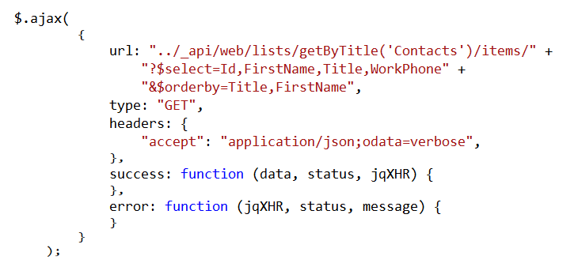
Using the REST API
Notes:
This is a READ sample. The other CRUD operations follow.

Slide 16
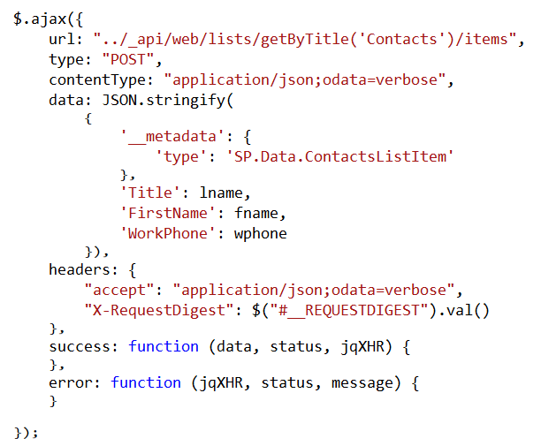
Create List Items

Slide 17
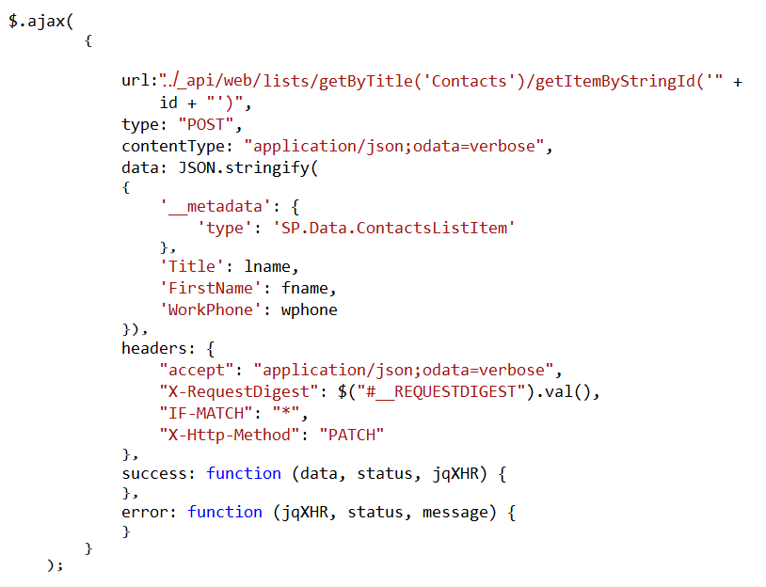
Update List Items

Slide 18
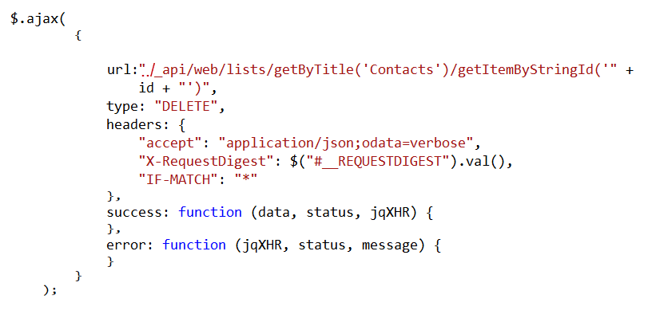
Delete List Items

Slide 19
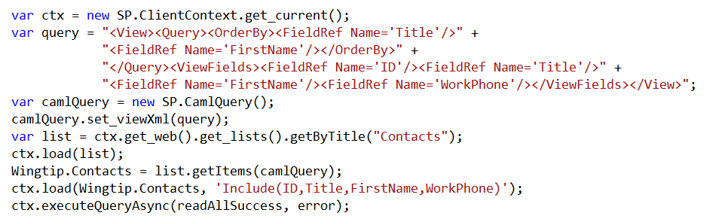
Using the CSOM API
Notes:
This is a READ sample. The other CRUD operations follow.

Slide 20
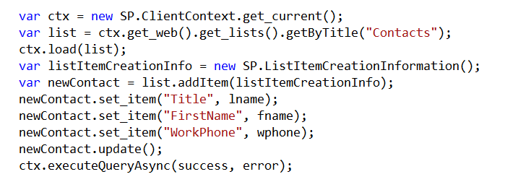
Create List Items

Slide 21
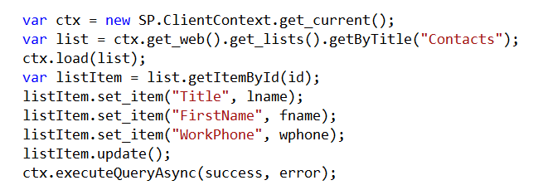
Update List Items

Slide 22
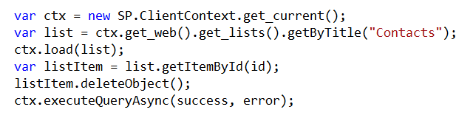
Delete List Items

Slide 23
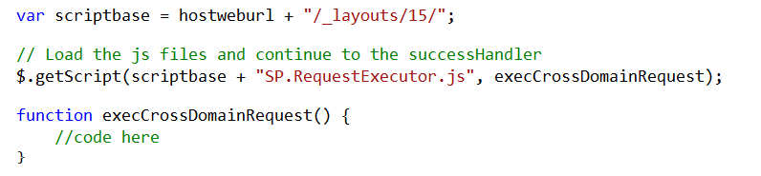
Cross Domain Library
Same-domain policy prevents JavaScript from making direct calls to the host web
SP.RequestExecutor.js located in LAYOUTS directory
Option 1: Reference directly
Option 2: Load dynamically
Notes:
Makes it possible to call the host web from JavaScript in the app web

Slide 24
Cross-Domain Library Architecture
Host Web
App Web
AppWebProxy.aspx
IFRAME
AppWebProxy.aspx
SP.RequestExecutor.js
SharePoint
Notes:
The app web loads the SPRequestExecutor.js library
The app web creates a new SP.RequestExecutor object, initializing it with the URL of the app web
This causes a hidden IFRAME to be created, which loads APPWebProxy.aspx from the LAYOUTS directory
The SP.RequestExecutor object uses the HTML5 postmessage command to send requests from the remote web
The request is executed by the AppWebProxy.aspx page
The response is returned

Slide 25
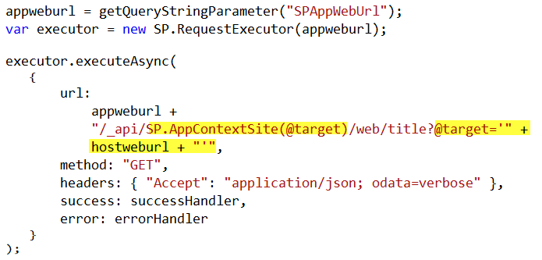
Cross-Domain REST Calls
Notes:
When calling the host web, you must switch the context

Slide 26
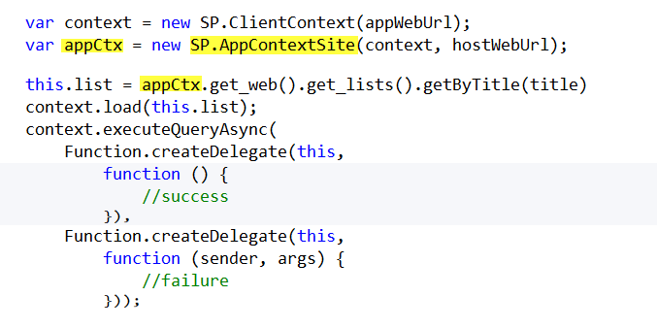
Cross-Domain CSOM Calls
Notes:
When calling the host web, you must switch the context

Slide 27
demo
CRUD operations against the host web

Slide 28
App Parts

Slide 29
App Parts
Allow functionality to be added to pages in the host web in a manner similar to web parts
App part is rendered through an IFrame on the host web
App part is defined using the Client Web Part
Supported in both SharePoint-hosted and Provider-hosted apps

Slide 30
Client Web Part
References the page that should display in the Iframe
Supports the creation of properties that appear in the property pane when the app part is added to a page in the host web

Slide 31
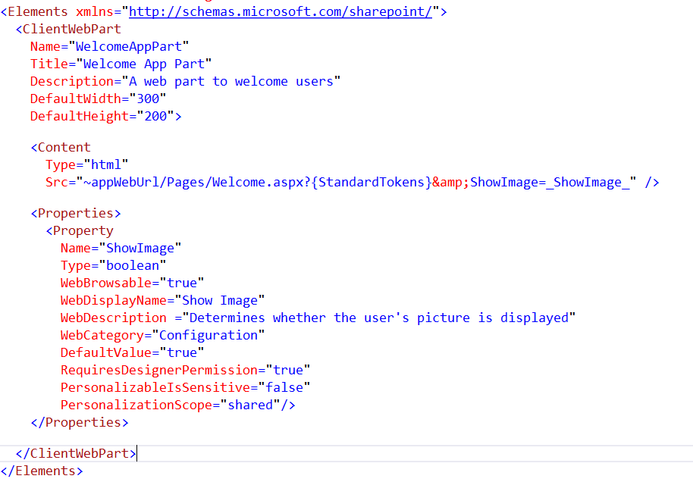
Client Web Part CAML

Slide 32
demo
App Parts

Slide 33
UI Custom Actions

Slide 34
UI Custom Actions
Can extend the Ribbon or Edit Control Block (ECB)
Launches a target page in your app
Supports the addition of tokens to pass information to the app

Slide 35
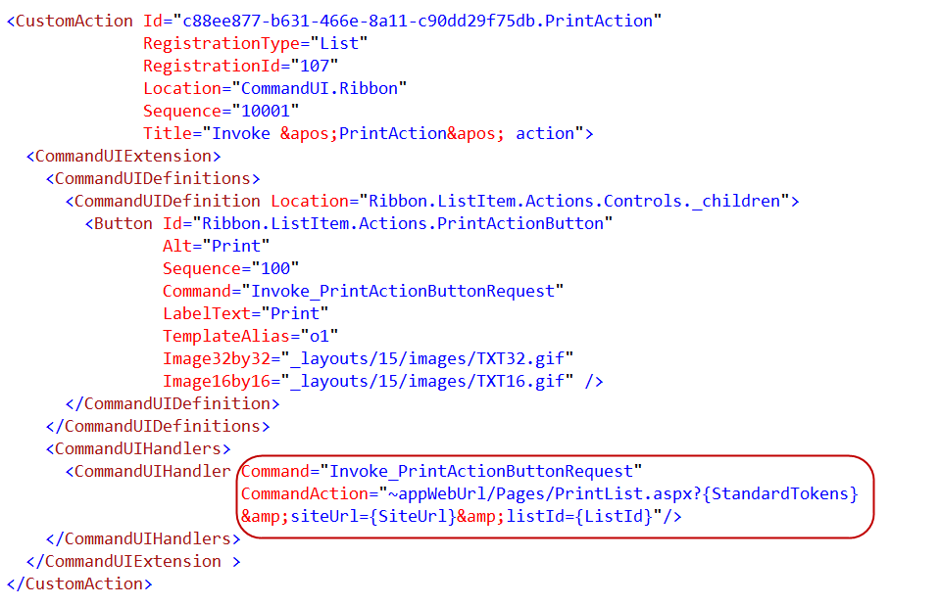
Custom Action CAML

Slide 36
demo
UI Custom actions

Slide 37
Summary
Introduction
Programming in JavaScript
App Parts
UI Custom Actions

Slide 38



dev.office.com
Sign up
http://dev.office.com/getting-started
Explore
http://apisandbox.msdn.microsoft.com
Get trained http://dev.office.com/training

Slide 39


Feedback
Office 365 Network Share you best practices and join conversations https://www.yammer.com/itpronetwork
Stackoverflow Ask deep technical questions to a world-wide set of developers
http://stackoverflow.com/questions/tagged/ms-office
UserVoice Provide suggestions of what you want in future versions
http://officespdev.uservoice.com/

Slide 40

© 2012 Microsoft Corporation. All rights reserved. Microsoft, Windows, and other product names are or may be registered trademarks and/or trademarks in the U.S. and/or other countries.
The information herein is for informational purposes only and represents the current view of Microsoft Corporation as of the date of this presentation. Because Microsoft must respond to changing market conditions, it should not be interpreted to be a commitment on the part of Microsoft, and Microsoft cannot guarantee the accuracy of any information provided after the date of this presentation. MICROSOFT MAKES NO WARRANTIES, EXPRESS, IMPLIED OR STATUTORY, AS TO THE INFORMATION IN THIS PRESENTATION.

